Slide 1
Chicago Restaurant Recommender System
Applied Data Science Capstone

Slide 2
PROBLEM
While browsing for restaurants on Foursquare users can be overwhelmed by choice.
Other users may be reluctant to try new eating establishments.
User dissatisfaction could drive them to other sites with a better user experience.

Slide 3
SOLUTION
We want to provide useful suggestions for new restaurants to better server our customers.
We have built a content-based recommender system to suggest new restaurants to users.

Slide 4




Data Collection
This data will be used to build recommendations for each user
Chicago Neighborhoods
Foursquare Venues
Users often prefer establishments in familiar neighborhoods.
We have gathered venues from Foursquare in each neighborhood.
Foursquare Users
Missing Date
Based on the venues we were able to find users that liked each.
Foursquare limits access to users’ dislikes and number of visits.

Slide 5
Machine Learning
One-Hot Encoding
Venue Categories
Neighborhoods
Combined Data
Each venue on Foursquare includes a category. We converted these categories into numerical features to better compare venues.
With 77 neighborhoods Chicago can be difficult to traverse. To build better recommendations we also applied one-hot encoding to our neighborhood data.
The categorical data for the venues and neighborhoods was then combined to build a richer dataset from which we could build our recommendations.

Slide 6
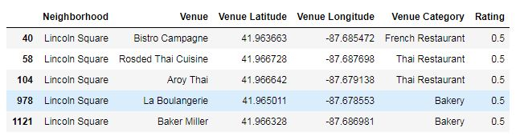
User Recommendations
By using a sample user’s previous ratings we were able to create a weighted list of recommendations

Slide 7
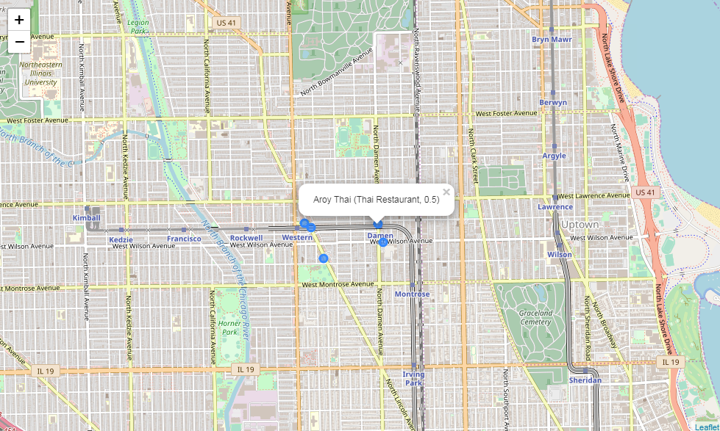
Mapping Our Results

Slide 8
CONCLUSION
The exercise was successful in delivering valuable recommendations for users.
Limitations on the available data may have reduced the depth of the model.
We were able to show the value in providing relevant suggestions to users.

